Slide 1


The Bylaws
2012-2013 CDCKI Membership Development and Education Committee

Slide 2
Bylaws
Rules adopted by an organization that are used to regulate its affairs and behavior of its members.
The bylaws of lower levels must be in accordance with higher levels
Must be kept up to date
Call 1-800-KIWANIS Ext. 411 for a copy

Slide 3
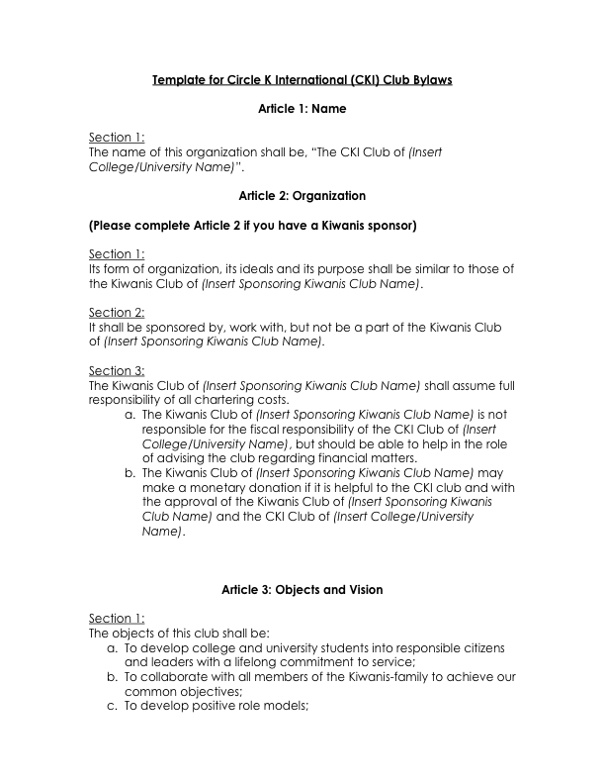

Slide 4
Amending Bylaws
Board submits proposal to club 14 days in advance
Club votes (2/3 majority required)
Submit amended bylaws to District Secretary-Treasurer for district board to approve

Slide 5
Amending Bylaws
What requires bylaws changes?
Dues
Standing Committees
Officer Changes (ex. different Vice-Presidents)
Notes:
Stress officer changes

